Slide 1

Autism Prediction
Madhuri Basava

Slide 2
Autism Prevention
Autism spectrum disorder is a developmental disorder that describes certain challenges associated with communication (verbal and non-verbal), social skills, and repetitive behaviors.
As of March 1st, 2020, 1 in every 54 children in the United States is affected by autism.
This project focuses on improving Autism Screening by creating models that can predict the likelihood of the individual suffering from autism based on the given features.
Early intervention and various therapies can help individuals with autism lead fulfilling lives.
Treatment approaches may include behavioral therapy, speech and language therapy, occupational therapy, and educational interventions tailored to the individual's needs.
Special education programs, social skills training, and assistive technologies can also be beneficial.

Slide 3
Dataset: Source
Dataset is taken from the Kaggle website: ASD Predictions with 8 different models [85.7%] | Kaggle

Slide 4
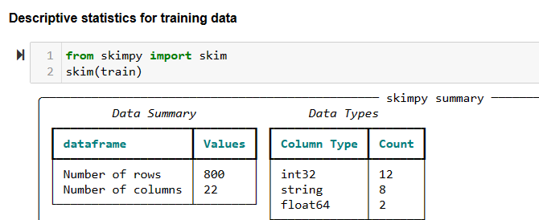
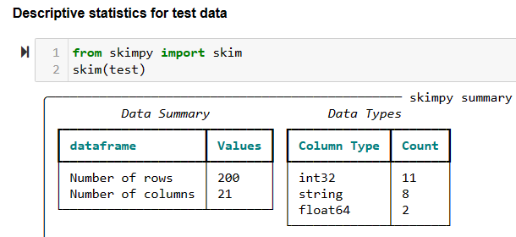
Data Understanding
Training data has 800 rows and 22 columns
Test data has 200 rows and 21 columns
No missing Values

Slide 5
Dataset: Numerical Features
Id - ID of the Individual that is the unique Identifier.
A1-A10 Score (Score based on Autism Spectrum Quotient (AQ) 10-item screening tool)
Age - Age of the individual in years
Result - Score for AQ1-10 screening test
Class (ASD) (The result is either 0 or 1. 0 -no autism and 1- Autism)

Slide 6
Dataset: Categorical Features
Gender - The gender of the individual
Ethnicity - Ethnicity of the individual
Jaundice - Whether the individual had jaundice at the time of birth.
Autism - Whether an immediate family member was diagnosed with autism.
Country_of_res - Country of residence of the individual.
Relation - Relation of an individual who completed the test.
Used_app_before - Whether the individual went through a screening test before.
age_desc - Age of the individual.

Slide 7
Methodology: Data Cleaning
Checked for null values. There are no null values.
Checked the ‘age_desc’ column has only one value. So, dropped it.
Dropped the id column.
Performed CHI Square and dropped the 'gender' and 'used_app_before' columns.
Converted Boolean yes/no variables to 0 (No) and 1 (Yes).
Scaled the ‘result’ and ‘age’ data using a RobustScaler.

Slide 8
Steps taken for Modeling
Load the data set into a data frame.
Perform the EDA to understand the characteristics of the data set.
Clean the data set. Remove the unnecessary features.
Evaluate the correlation between the variables in the dataset.
Apply various models to the data set.
Create a confusion matrix to show the performance of each model to evaluate the predicted values from the model vs. the actual values from the test dataset.
Calculate the accuracy for each model and choose the best model.

Slide 9
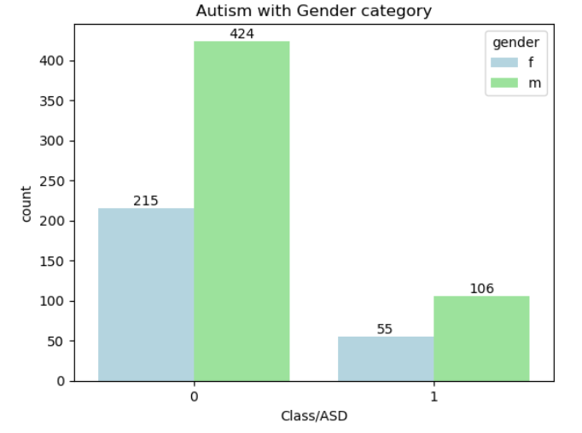
Correlation between the variables
From the above chart, we can conclude that the female percentage is approximately half of the male percentage in both those not having autism conditions and those with autism conditions.

Slide 10
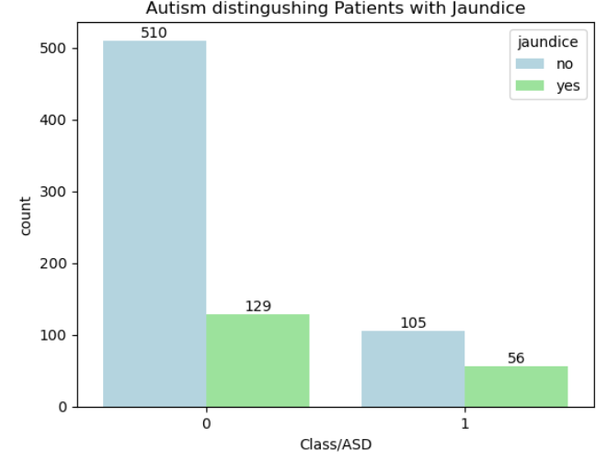
Correlation between the variables
From the above chart, we can conclude that at least half of the patients with autism have Jaundice.

Slide 11
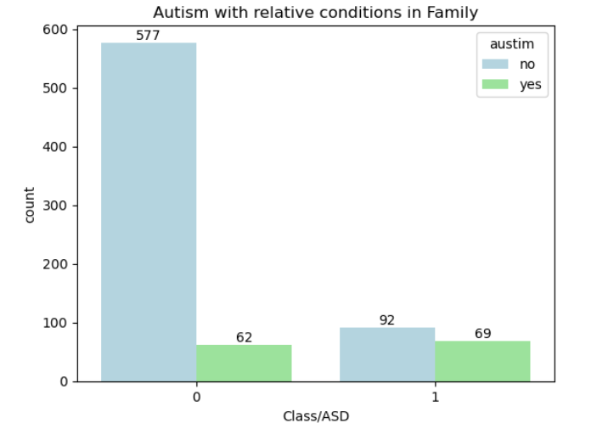
Correlation between the variables
From the above chart, we can conclude that most patients have relatives with autism in the family.

Slide 12
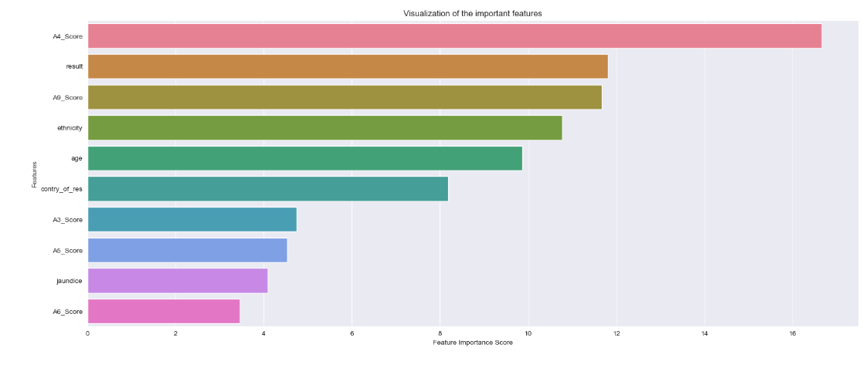
Results: Feature Importance

Slide 13
Methodology: Algorithms
K Nearest Neighbors
Decision Tree
LGBM (Light Gradient Boosting Machine)
XGBRF (Extreme Gradient Boost-Random Forest)
Cat Boost Classifier
Random Forest Classifier
Logistic Regression
SVC (Support Vector Classifier)

Slide 14
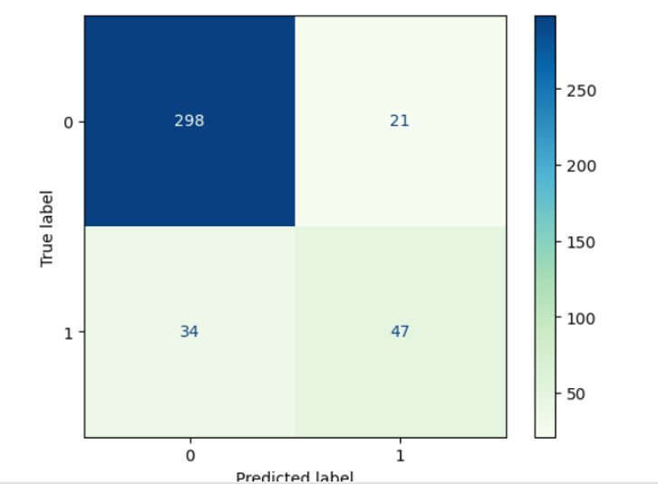
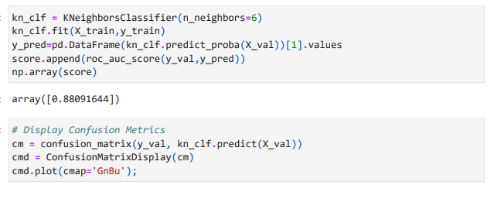
Results: Evaluation
1) K NearestNeighbours Model

Slide 15
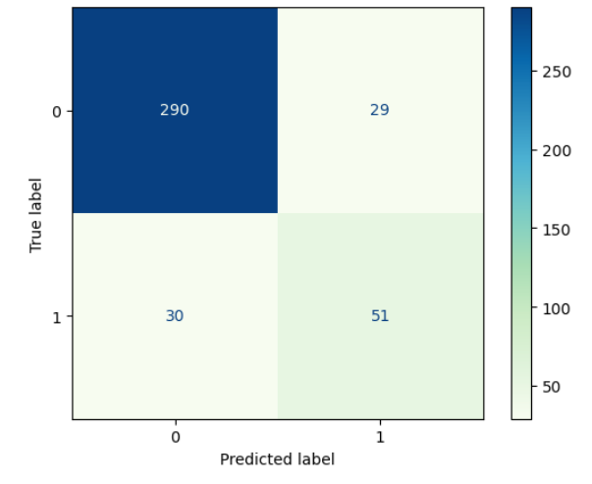
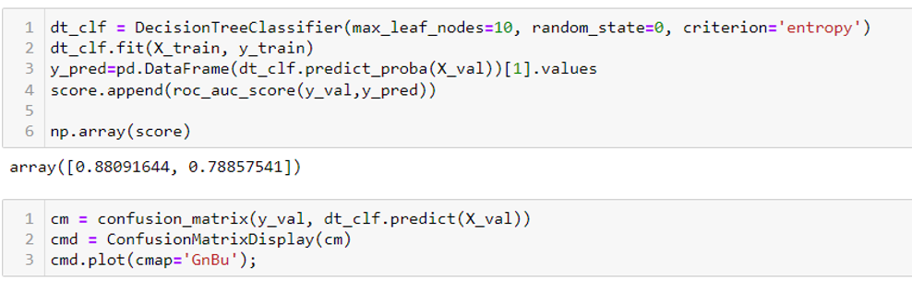
Results: Evaluation
2) Decision Tree

Slide 16
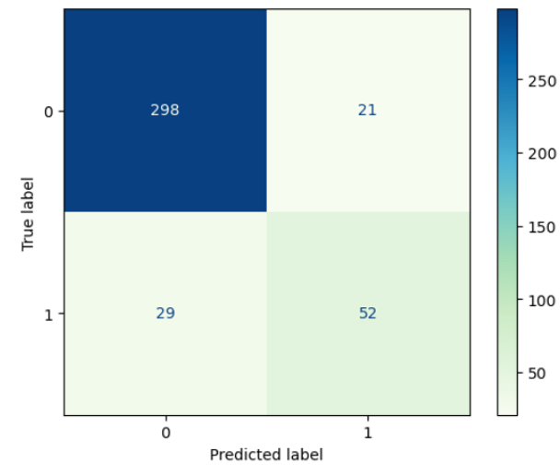
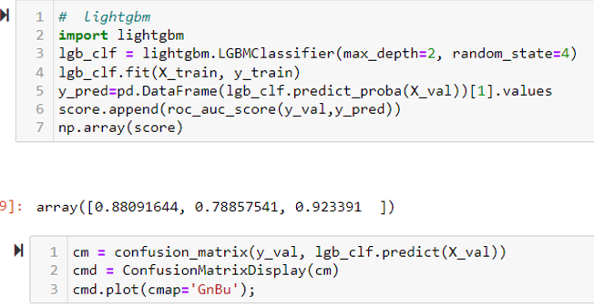
Results: Evaluation
3) LGBM(Light Gradient Boosting Machine)

Slide 17
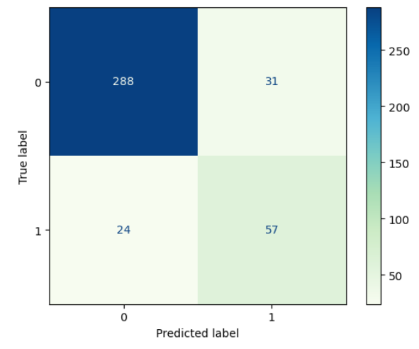
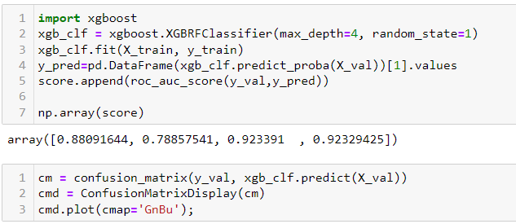
Results: Evaluation
4) XGBRF (Extreme Gradient Boost-Random Forest)

Slide 18
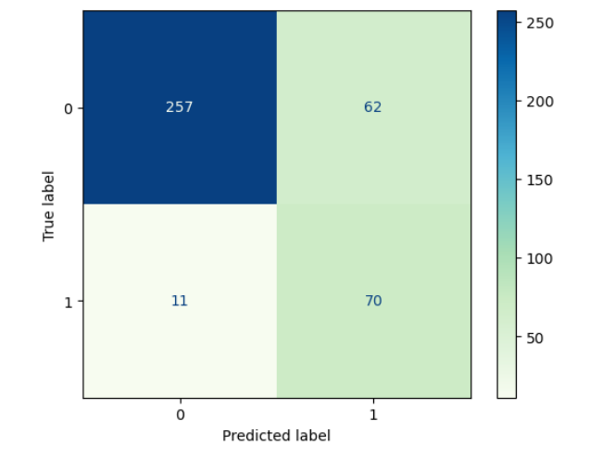
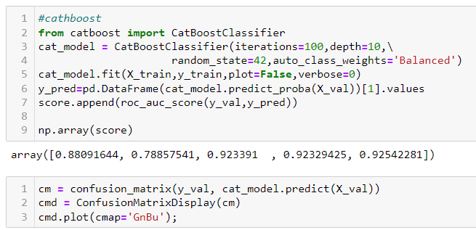
Results: Evaluation
5) Cat Boost Classifier Model

Slide 19
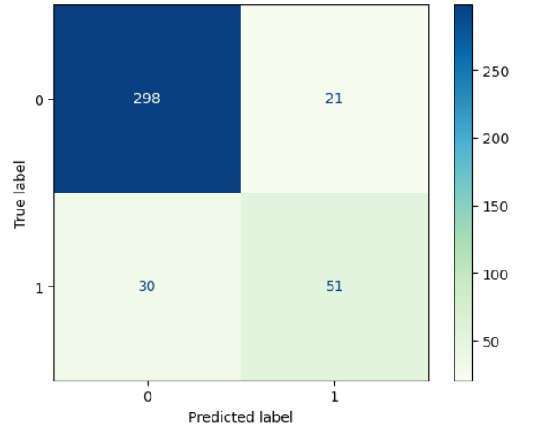
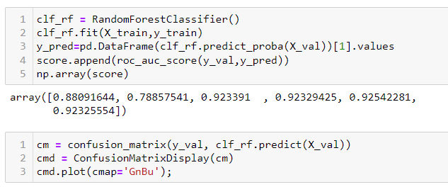
Results: Evaluation
6) Random Forest

Slide 20
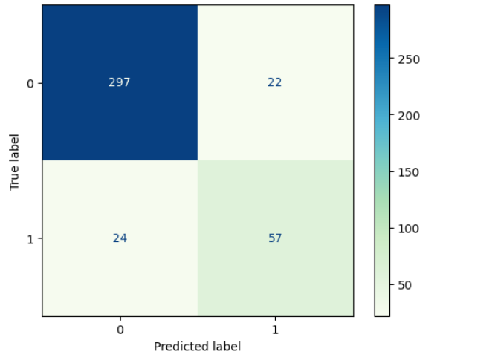
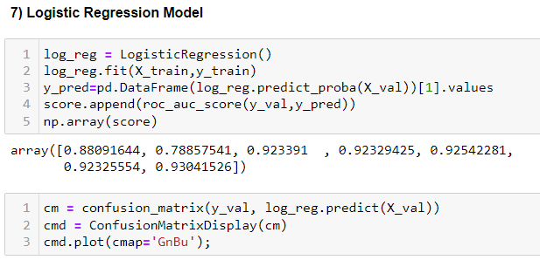
Results: Evaluation
7) Logistic Regression Model

Slide 21
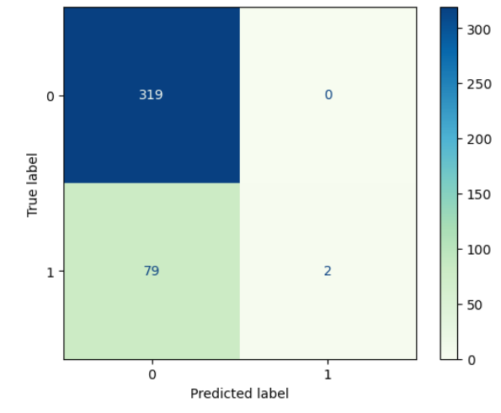
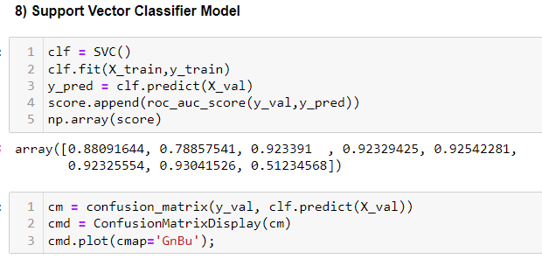
Results: Evaluation
8) SVM (Support Vector Machine)

Slide 22
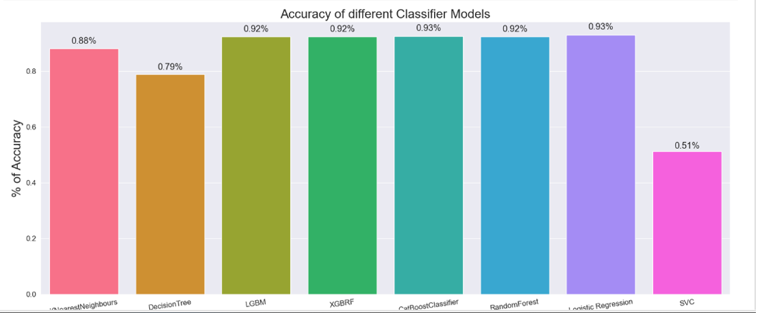
Best Model Selection

Slide 23
Conclusion
Categorical Boost Classifier and Logistic Regression are the best Models which gave 93% accuracy.
Individuals and families need to be notified about the limitations, implications, and potential consequences of the prediction.
Need to raise awareness about autism, and promote understanding of predictive modeling in healthcare.¶

Slide 24
References
Autism prediction dataset retrieved from Kaggle website: ASD Predictions with 8 different models [85.7%] | Kaggle
A new machine learning model based on induction of rules for autism detection - Fadi Thabtah, David Peebles, 2020 (sagepub.com)
Detecting autism spectrum disorder using machine learning techniques - PMC (nih.gov)
Autism Prediction with CatBoost | Kaggle
A routine prenatal ultrasound can identify early signs of autism, study finds | ScienceDaily
Machine learning analysis of pregnancy data enables early identification of a subpopulation of newborns with ASD - PMC (nih.gov)

